Slide 1
Heart disease prediction using Machine learning
CAPSTONE PROJECT
Presented By:
Swetankan Kumar Sinha Indian Institute of Technology Patna
Computer Science & Data Analytics

Slide 2
OUTLINE
Problem Statement
Proposed System/Solution
System Development Approach
Algorithm & Deployment
Result
Conclusion
Future Scope
References

Slide 3
Problem Statement
Cardiovascular diseases (CVDs), including heart disease, are the leading cause of death globally. Early detection and intervention are crucial for improving patient outcomes. However, traditional diagnostic methods can be expensive, invasive, or time-consuming. The dataset provides the patients’ information. It includes over 1,000 records and 14 attributes. Each attribute is a potential risk factor. There are both demographic, behavioral, and medical risk factors.

Slide 4
Proposed Solution
The project aims to predict heart disease using a machine learning model. It starts with data pre-processing steps like handling missing values and encoding categorical variables. Classification algorithms including Logistic Regression, SVC, and KNN are applied, along with non-linear methods like Decision Trees, Random Forest, and Gradient Boosting. The solution will consist of the following components:
Data Prep
Import libraries (pandas, scikit-learn)
Load & clean data (handle missing values, duplicates)
Encode categorical features, scale continuous features
Model Training
Split data into training and testing sets
Train various models (Logistic Regression, SVM, KNN, etc.)
Evaluate and select the best performing model (e.g., Random Forest)
New Data Prediction
Use the trained model to predict heart disease risk for new data points

Slide 5
Proposed Solution – CONT.
Benefits :-
Non-invasive way to assess heart disease risk
Machine Learning models can learn complex patterns in data
Potential for early detection and intervention
Overall, this approach provides a framework for heart disease prediction using various machine learning techniques.

Slide 6
System Approach
Building the proposed solution would involve a combination of data processing, Visualizing dataset, and machine learning. Here are the key system and library requirements:
System requirements:
Hardware:
CPU : The code should run efficiently on modern CPUs, preferably with multiple cores for parallel processing.
RAM: At least 4 GB of RAM is recommended, although more may be necessary for larger datasets or more complex models.
GPU: GPU is optional. If GPU acceleration is desired, a compatible GPU with CUDA support would be necessary.
Software:
Operating System: The code should be compatible with major operating systems like Windows, macOS, and Linux. Ensure that the necessary dependencies are compatible with the chosen operating system.
Software: Python interpreter is required to execute the code. Additionally, a text editor or an Integrated Development Environment (IDE) such as Jupyter Notebook or Google Colab can be used to write, edit, and execute the code. Google Colab can directly execute the provided notebook (.ipynb) file.

Slide 7
System Approach - CONT.
Library required to build the model:
Data Processing and Analysis:-
Pandas: For data manipulation and analysis.
Data Visualization:
Matplotlib
Seaborn
Machine Learning Models:
Scikit-learn (or sklearn)
GUI Development:
ipywidgets
Model Persistence:
Joblib

Slide 8
Algorithm & Deployment
In the Algorithm section, describe the machine learning algorithm chosen for predicting heart disease. Here's an example structure for this section:
Data Import and Pre-processing
Imports libraries like pandas and scikit-learn
Reads the heart disease data
Removes duplicate data entries
Identifies categorical and continuous features
Encodes categorical features using one-hot encoding (excluding sex and target)
Performs feature scaling on continuous features using StandardScaler
Train-Test Split
Splits the data into training and testing sets for model evaluation (70/30 split)
Model Training and Evaluation
Trains various machine learning models like : Logistic Regression, Support Vector Machine (SVM), K-Nearest Neighbours (KNN) with hyperparameter tuning, Decision Tree Classifier, Random Forest Classifier, Gradient Boosting Classifier
Evaluates each model's performance using accuracy score on the test set

Slide 9
Algorithm & Deployment – CONT.
Comparison and Selection
Compares the accuracy scores of all models and identifies Logistic Regression as the best performer
New Data Prediction
Defines a new data point with specific features
Uses the trained Random Forest model to predict the presence or absence of heart disease for the new data
Model Persistence
Saves the Random Forest model using joblib for future use.
GUI Integration
Includes ipywidgets GUI in Google Colab to take user input for various features and display the predicted heart disease risk.
Result: 84% accuracy

Slide 10
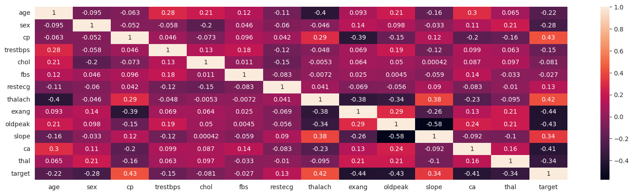
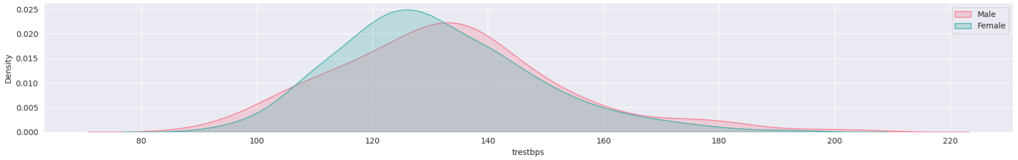
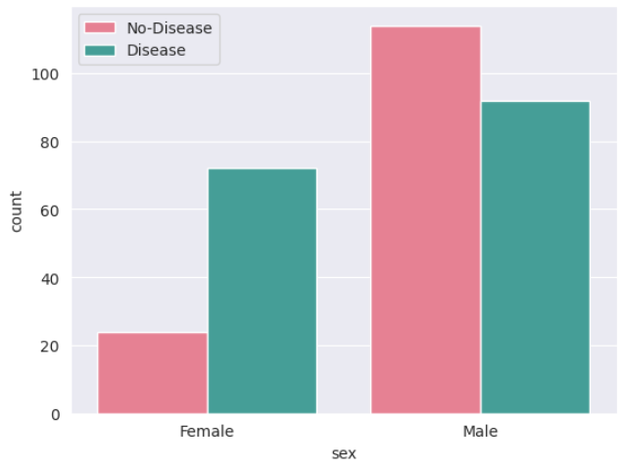
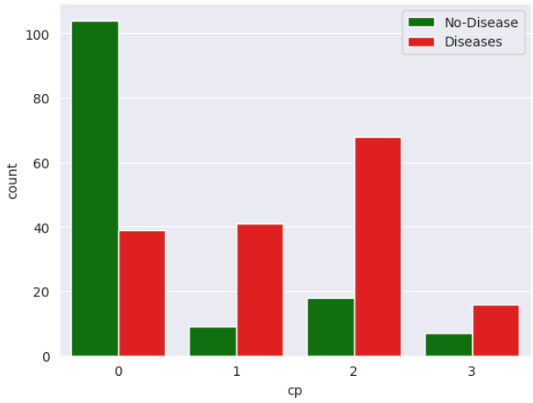
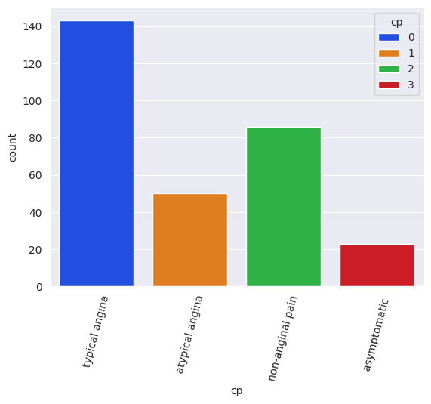
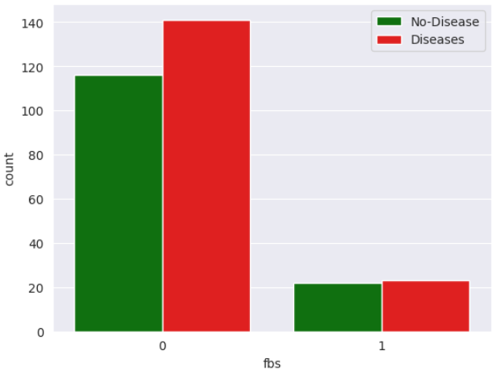
Result
Results of the machine learning model in terms of its accuracy and effectiveness in predicting Heart Disease. Include visualizations and comparisons between predicted and actual counts to highlight the model's performance.

Slide 11
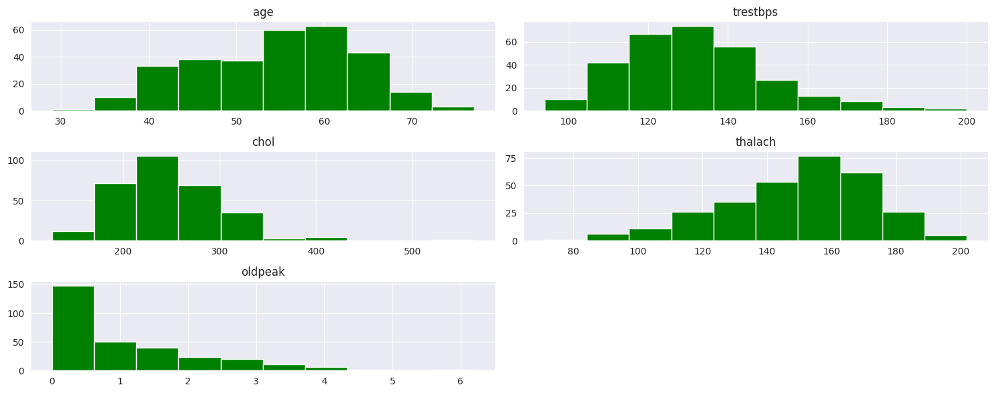
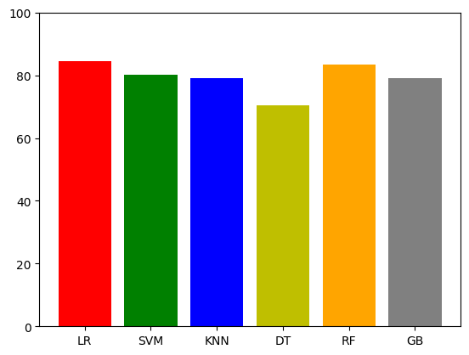
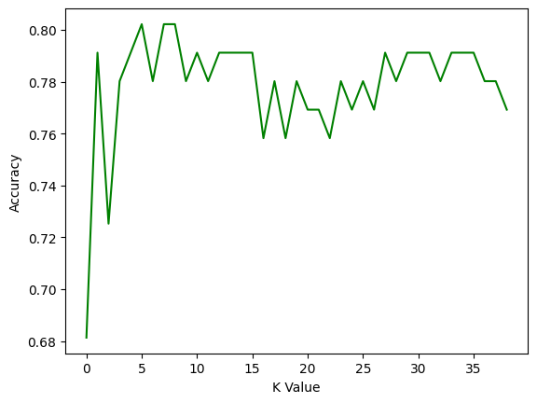
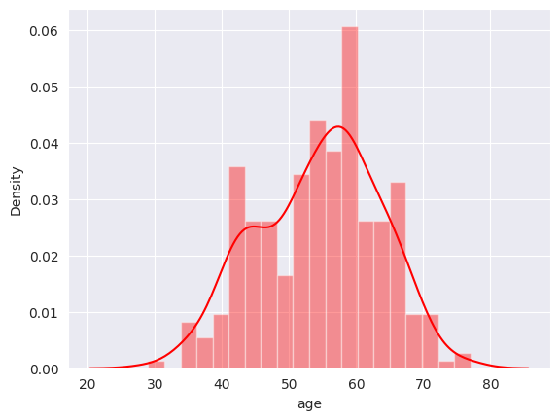
Result

Slide 12
Conclusion
This code offers a comprehensive framework for predicting heart disease risk using machine learning. By leveraging various algorithms like Random Forest and employing techniques like data pre-processing and model evaluation, the system can analyse patient data and provide insights into potential heart disease. Additionally, the optional GUI component enhances accessibility, allowing users to conveniently interact with the system for risk assessment.
This approach holds promise for non-invasive heart disease risk assessment, potentially enabling early detection and intervention.

Slide 13
Future scope
The proposed solution lays the foundation for ongoing advancements in the realm of heart disease prediction optimization. This could include incorporating additional data sources, optimizing the algorithm for better performance, and expanding the system to cover multiple parameters. Consider the integration of emerging technologies such as edge computing or advanced machine learning techniques and provide real-time prediction.

Slide 14
References
https://www.kaggle.com/datasets/johnsmith88/heart-disease-dataset/data
https://pandas.pydata.org/pandas-docs/stable/user_guide/index.html
https://seaborn.pydata.org/https://matplotlib.org/stable/contents.html
https://matplotlib.org/stable/contents.html
https://scikit-learn.org/stable/user_guide.html

Slide 15
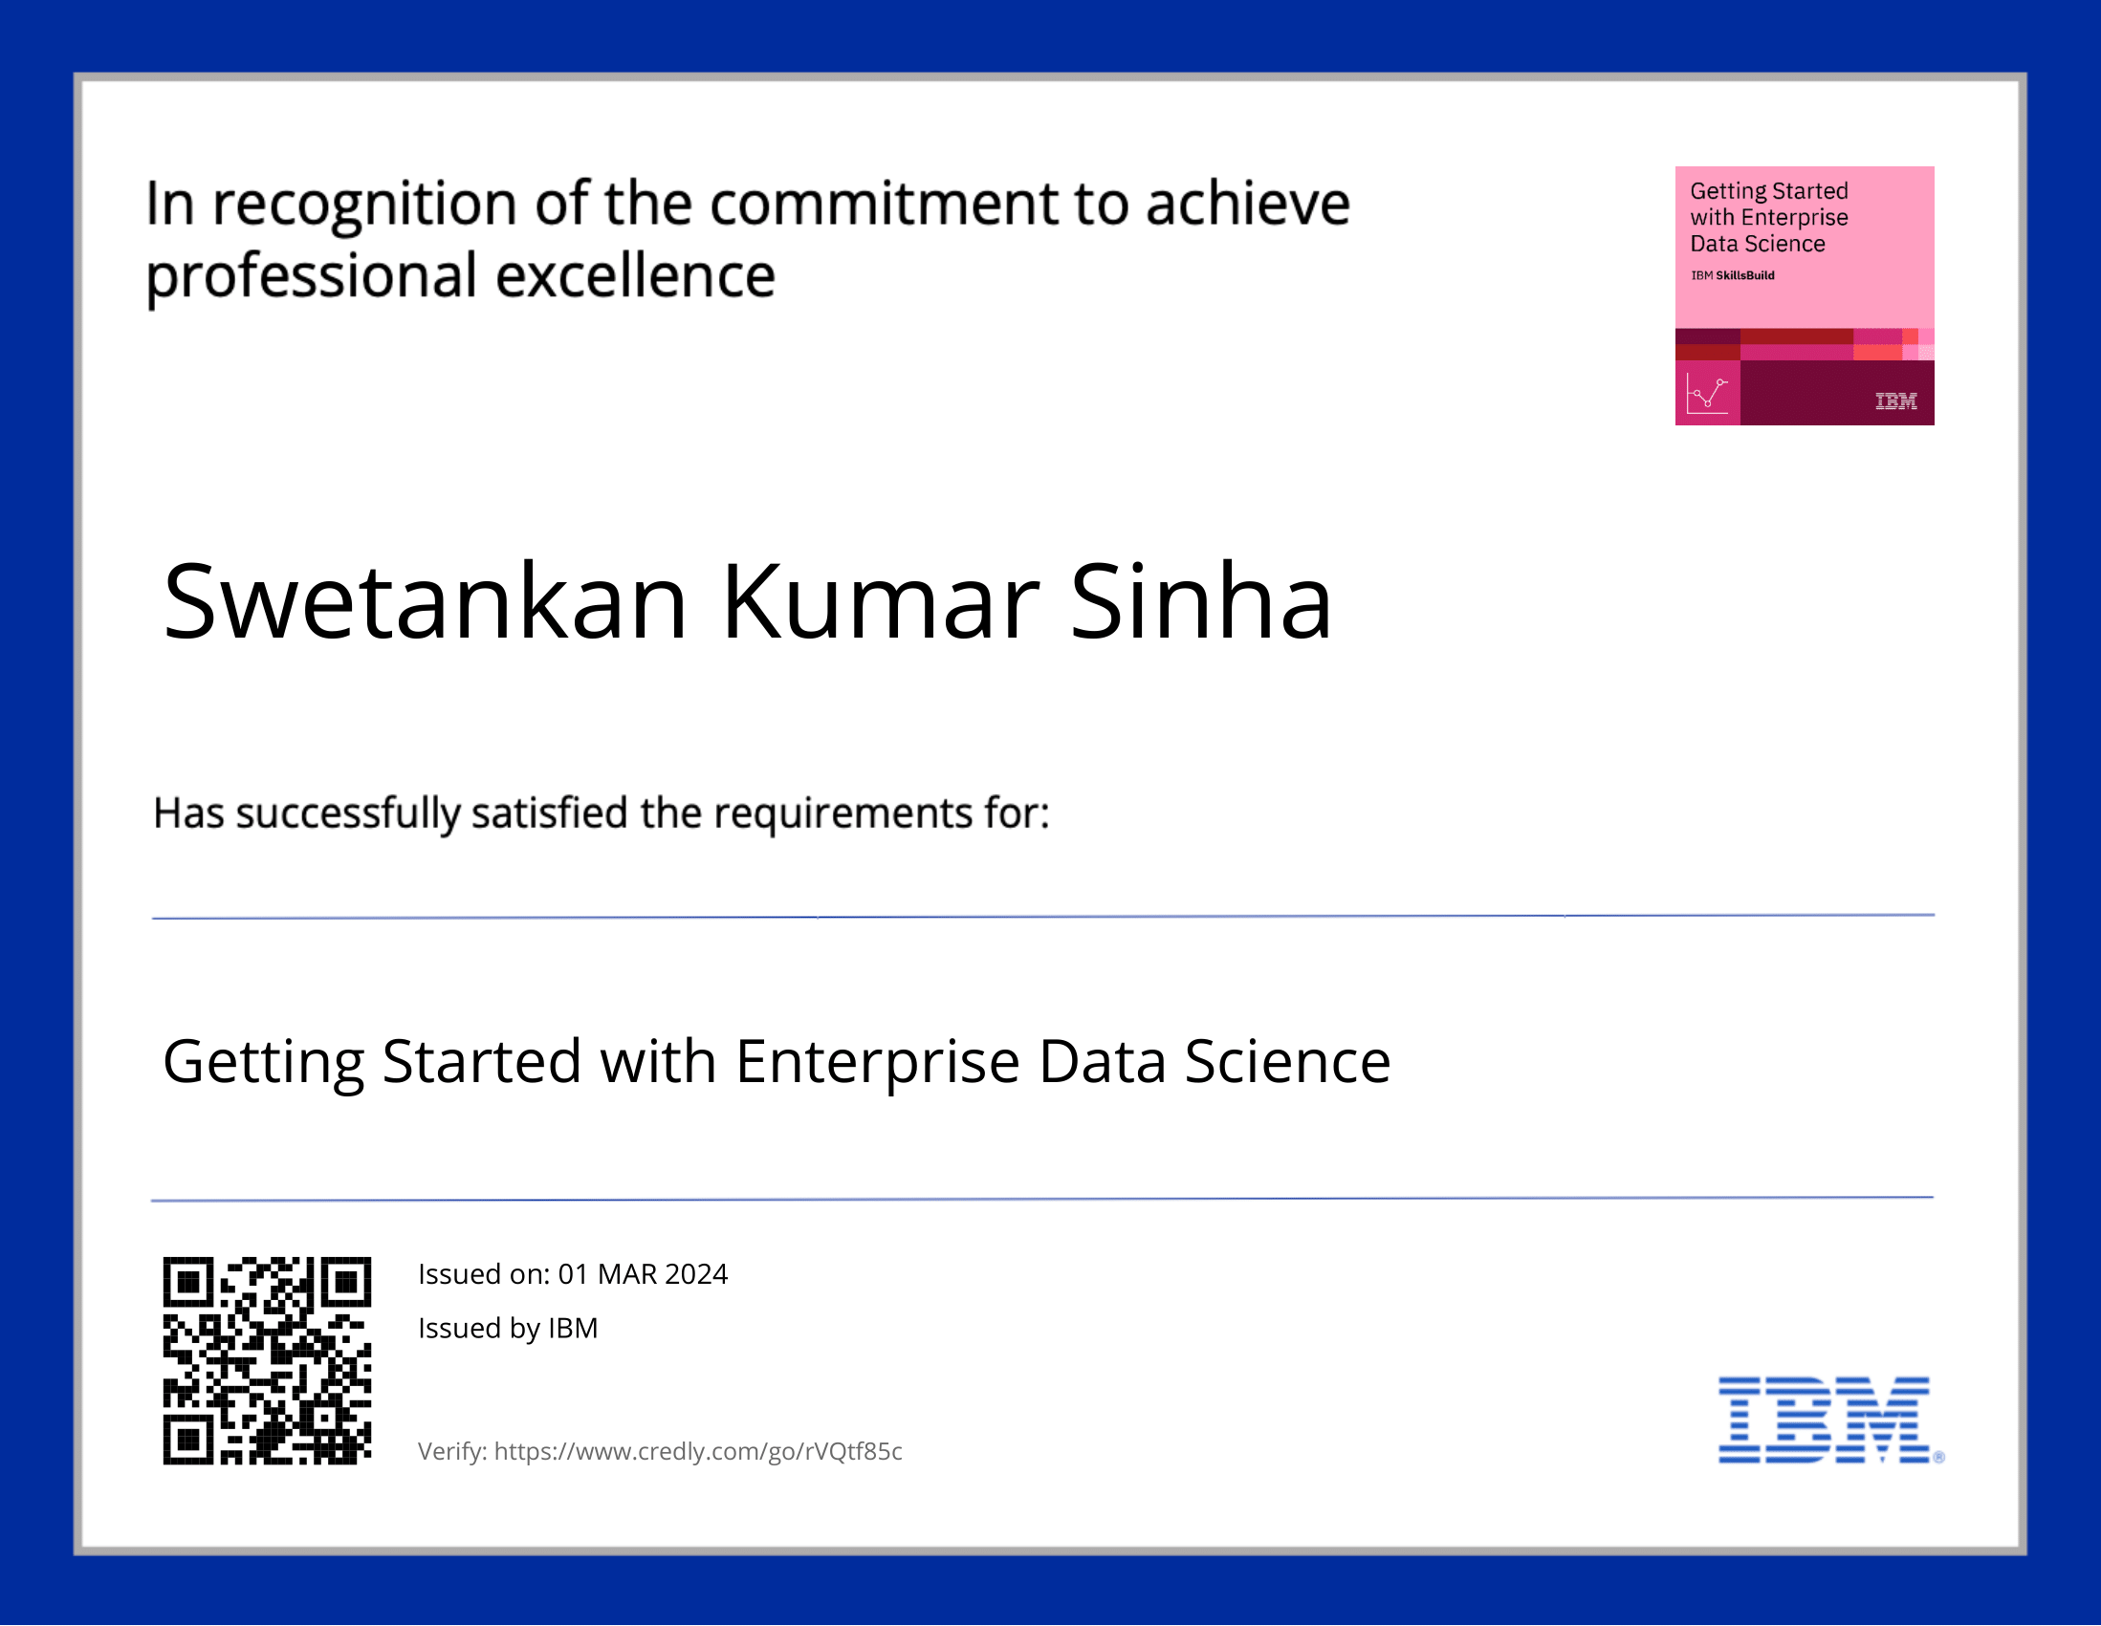
course certificate 1

Slide 16
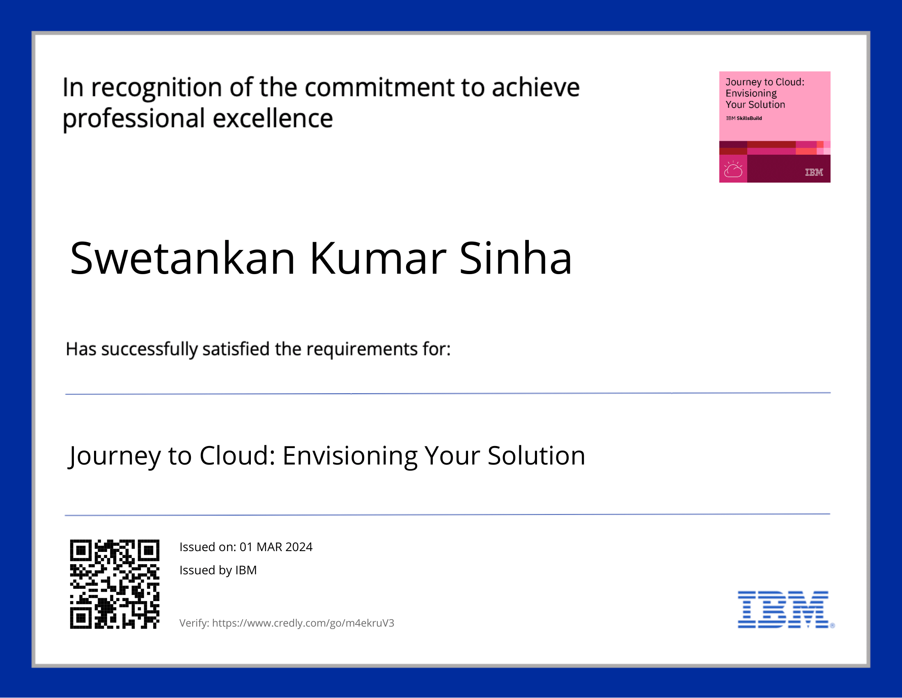
course certificate 2

Slide 17
THANK YOU

